Slide 1
Investigating the 3rd Party Android Apps
Part 2: TextNow
Notes:
https://digitalcorpora.s3.amazonaws.com/corpora/mobile/android_10/Non-Cellebrite%20Extraction/Pixel%203.zip

Slide 2




Approach
Approach to answer the question

Slide 3
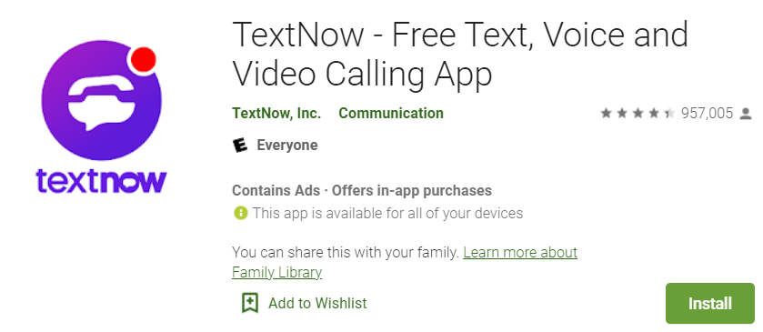
Investigating TextNow app

Slide 4
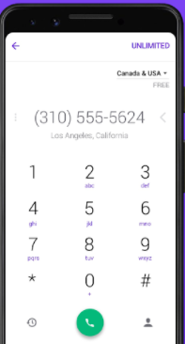
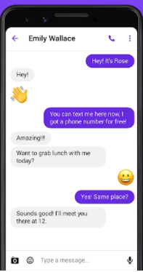
What is textnow app?
Main features
Offers users a local second phone number
Free calls, video calls, text messages
Evidence types:
Username
Messages
Contacts
Phone numbers

Slide 5
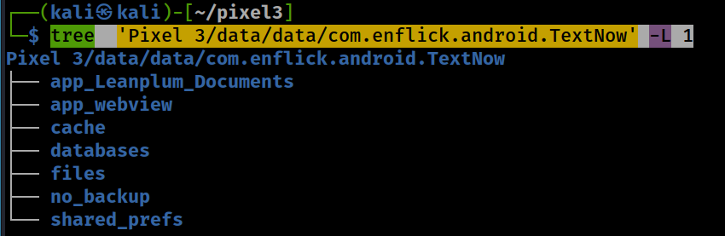
App File structure
Notes:
tree 'Pixel 3/data/data/com.enflick.android.TextNow' -L 1

Slide 6
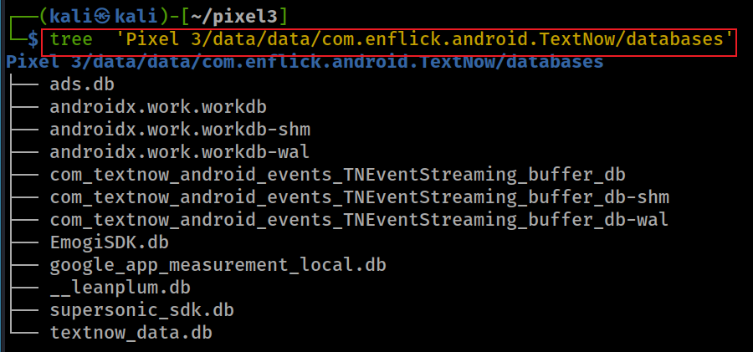
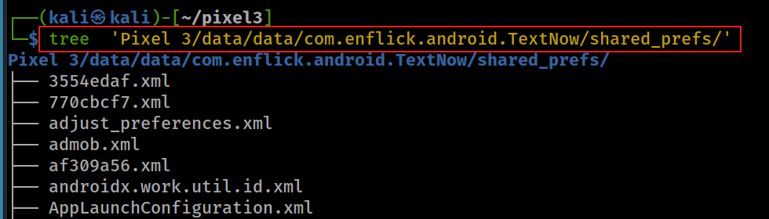
Show database folder
Show shared_prefs folder

Slide 7
Scenario
The suspect’s phone has installed a TextNow app.
Questions
What is the phone number that is associated with TextNow app?
What is the username?
How many contacts are saved in TextNow?
Are they conversations between 2-4pm (local time)?

Slide 8
What phone number is associated with textnow app?
search the username associated with the app
Notes:
grep 'phone' 'Pixel 3/data/data/com.enflick.android.TextNow/shared_prefs/com.enflick.android.TextNow_preferences.xml'

Slide 9
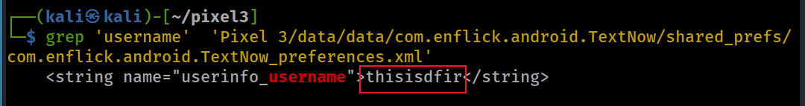
What is the username for textnow?
search the username associated with the app
Notes:
grep 'username' 'Pixel 3/data/data/com.enflick.android.TextNow/shared_prefs/com.enflick.android.TextNow_preferences.xml'

Slide 10
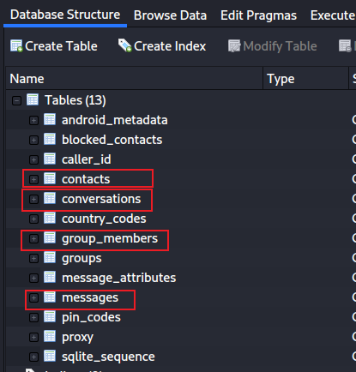
How many contacts are saved in TextNow?
Show all tables in textnow_data.db
Notes:
sqlitebrowser 'Pixel 3/data/data/com.enflick.android.TextNow/databases/textnow_data.db'

Slide 11
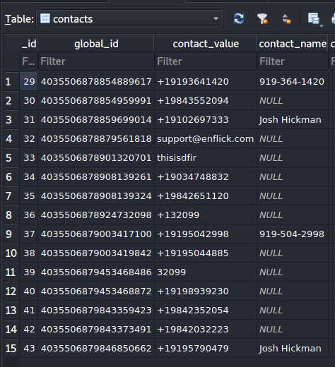
Check contact table
Contact’s phone number
Name of the contact

Slide 12
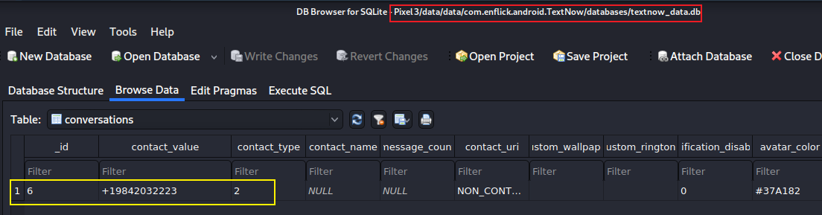
Are there conversations between 2-4pm (local time)?
Check conversations table
Notes:
Cmd: sqlitebrowser 'Pixel 3/data/data/com.enflick.android.TextNow/databases/textnow_data.db'

Slide 13
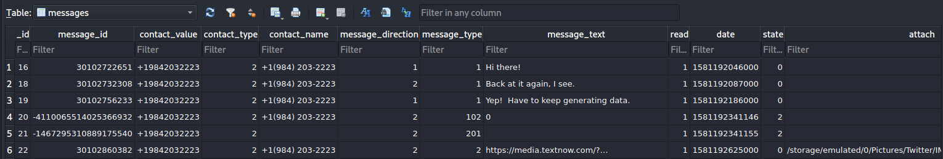
List messages in the message table
message content
direction flag
1: received
2: sent
1: text msg
102, 201: audio
2: picture
when a message was sent
phone number of the sender ( refers to conversation table)
name of the sender (number if no names)
read flag
attachment. e.g., picture
sort by date

Slide 14
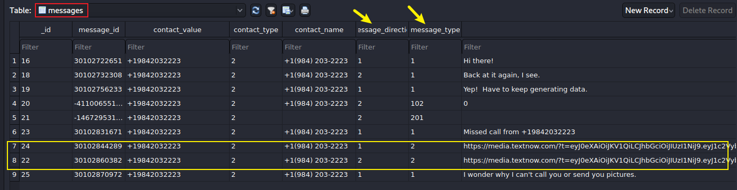
Any pictures sent/received?
Notes:
/storage/emulated/0/Pictures/Twitter/IMG_20200203_213034.jpg

Slide 15
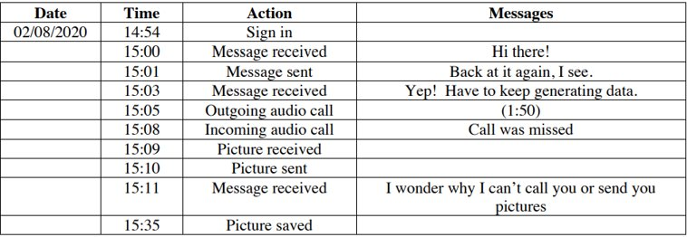
Message results

Slide 16
To summarize
Locate the app directory and search username, phone number keywords using grep to find them
Find app package/folder and look at the databases list
Go to textnow_data.db to find the messages and contacts

